Slide 1

HALO:
High-efficiency Autonomous Low-SWaP Operations
Sloan Hatter, Blake Gisclair
Advisor: Dr. Ryan T. White

Slide 2

MILESTONE 3 PROGRESS MATRIX
Task | Completion % | Sloan | To Do
Hardware Swap | 100% | Switch out Pi for Jetson | None
Post Processing Scripts for Raspberry Pi | NULL | NULL | NULL
Run HALO on Jetson | 100% | Load HALO onto Jetson | None
8-bit Representation | 50% | Implement | Implement the INT8 quantization methods.

Slide 3
TASKS COMPLETED
Hardware Swap
Raspberry Pi 5 AI HAT+ → Jetson AGX Orin
Post-Processing Scripts for Raspberry Pi
Pi scripts would not work on Jetson, so they have been discarded
Run HALO on Jetson
Load HALO onto Jetson, ensure it can run
8-bit Representation
Utilize the NVIDIA TensorRT INT8 package from NVIDIA JetPack SDK

Slide 4
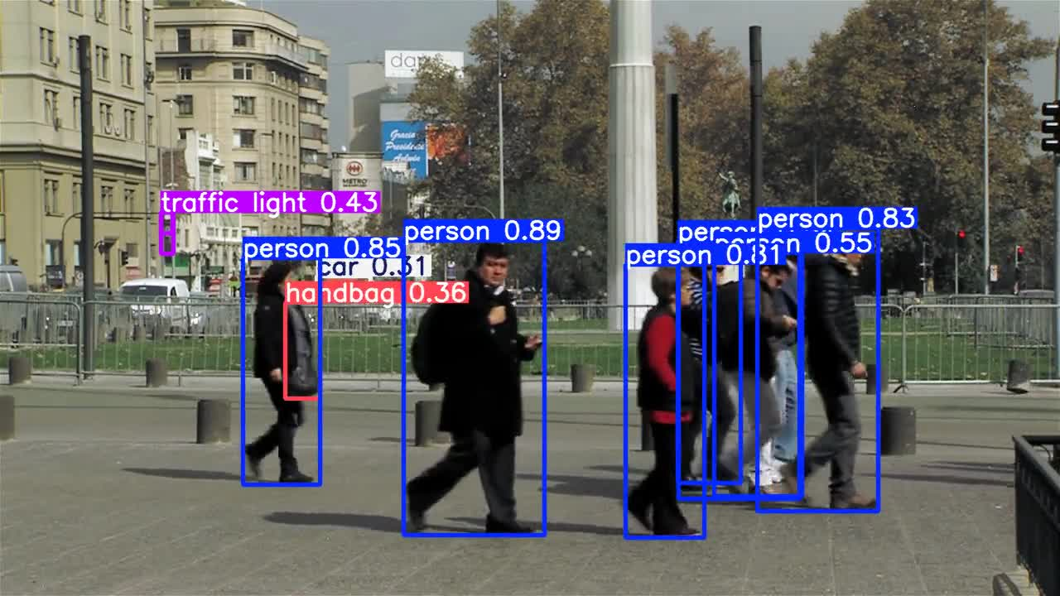
DEMO

Slide 5

MILESTONE 4 TASK MATRIX
Task | Sloan
4-bit Representation | 100%
Tune 4-bit Model | 100%
Research algorithms for binary quantization | 100%

Slide 6
MILESTONE 4 TASKS
4-bit Representation
Utilize the NVIDIA TensorRT INT4 package from NVIDIA JetPack SDK
Tune 4-bit Model
Utilize the Quantized-Aware Training method from the NVIDIA TensorRT package
Research Algorithms for Binary Quantization
Research 1-bit quantization algorithms that focus on recouping accuracy loss

Slide 7

THANK YOU!
QUESTIONS?

